Slide 1
Preprocessing Algorithms for neural networks
A study on preprocessing algorithms for an Xception neural net for plant seedling classification
Presented by Tyler G. Hudson

Slide 2
Introduction
This project is intended to assess the usefulness of several image pre-processing and segmentation techniques in image recognition with an Xception neural network with AdaDelta optimization.

Slide 3
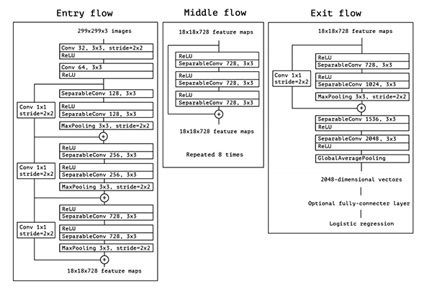
The Neural Network
Imagenet-Trained Xception Network with Global Average Max Pooling
Untrainable
Dropout (0.5)
Dense (1024, ReLu)
Dropout (0.5)
Dense (12, Softmax)
Optimizer: AdaDelta
Not optimal but timely
Convergence in ~10 Epochs
Overfitting Problems (75% Test, 45% Train)
A diagram of the Xception Neural Network structure

Slide 4
Proposed/Discarded Methods
Alternate Network Architectures:
Self-trained convolutionary network
Converged badly, failed to fit test data (10-15% train)
ResNet50 (ImageNet trained)
Significant overfitting (85-90% train, 10-15% test)

Slide 5
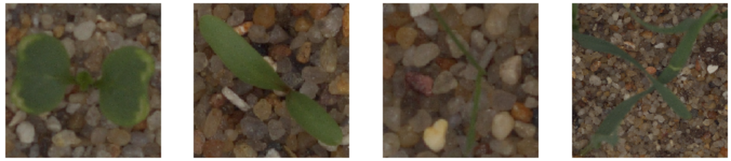
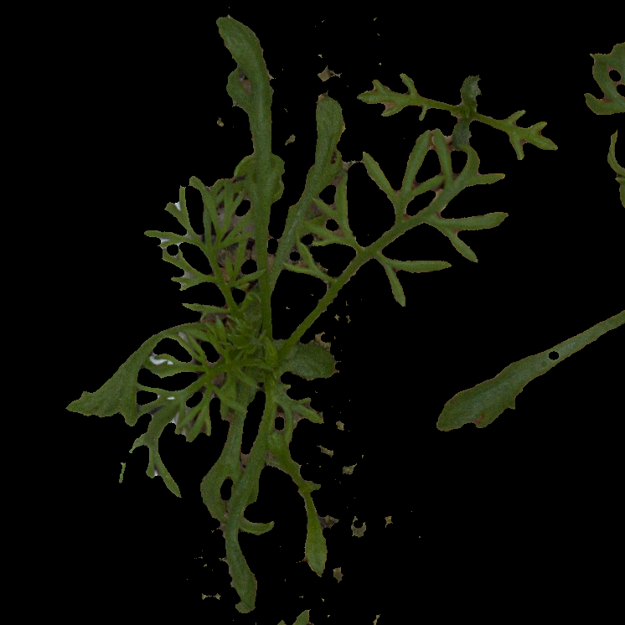
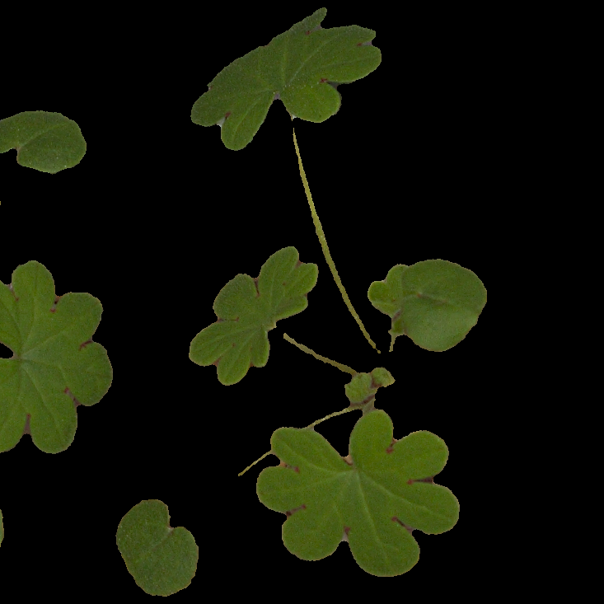
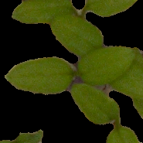
The Data
4,750 images of pre-classified plant seedlings from a Kaggle Playground competition
90% Train
10% Test
All resized to 256x256
Also, the same data pre-segmented using Gábor Vecsei’s HSV segmentation algorithm

Slide 6
The Processing techniques
ImageDataGenerator: Rotate, Zoom, Stretch, Flip
Histogram Equalization
Histogram Equalization using HSV format
Segmentation Algorithms
HSV segmentation using Gábor Vecsei’s algorithm (pregenerated)
CIELUV Color Thresholding on 3 sample colors

Slide 9
Results
The Image Data Generator often made the network less accurate on the test data, but also often decreased Loss (sometimes significantly)
Histogram equalization was very lossy, especially with HSV
Image segmentation presents a very significant improvement in performance on test data.
CIELUV performed slightly better than Vecsei’s algorithm

Slide 10
Future Work
Implement a more accurate network
Use model prediction to further assess accuracy
Was the model equally accurate for all classes?
Did different models perform better on different data?
Find more image preprocessing techniques
Verify findings with additional data
Segmentation was very simple for this task, may be harder for others

Slide 11
Works Cited
Anish, J. (2017, November 05). The Idea of preparing your own Dataset for convolutional neural network. Retrieved from https://becominghuman.ai/the-idea-of-preparing-your-own-dataset-for-convolutinal-neural-network-49ec097b8313
Chollet, F. (2017, April 04). Xception: Deep Learning with Depthwise Separable Convolutions. Retrieved from https://arxiv.org/abs/1610.02357
Chu Te, I. (n.d.). Background Removal (CIELUV Color Thresholding). Retrieved from https://www.kaggle.com/ianchute/background-removal-cieluv-color-thresholding/notebook
Sebastian Ruder. (2018, April 16). An overview of gradient descent optimization algorithms. Retrieved from http://ruder.io/optimizing-gradient-descent/index.html#visualizationofalgorithms
Vecsei, G. (n.d.). Plant Seedlings Fun with Computer Vision. Retrieved from https://www.kaggle.com/gaborvecsei/plant-seedlings-fun-with-computer-vision/notebook
D., M., Zeiler. (2012, December 22). ADADELTA: An Adaptive Learning Rate Method. Retrieved from https://arxiv.org/abs/1212.5701

